Slide 1
Integrated Plant leaf Disease Detection Robot : Combined Detection of Powdery Mildew and Tomato Spotted Wilt Virus in Tomato’s plants by using An Embedded System and Machine Learning Approach for Precision Agriculture

Slide 2
Presented By:
Sakib Nesar Ratul
ID – 201-35-3080
Department of Software Engineering
Faculty of Science and Information Technology
Supervised By:
Mr. Md. Kaimujjaman
Lecturer
Department of Software Engineering
Faculty of Science and Information Technology
Daffodil International University

Slide 3
Table of content
Introduction
Background & Motivation
Literature Review
Research Gap
Problem Statement
Project Objectives
Methodology-Overview
System Protocols
Proposed Models & Methods
System Architecture
Dataset & Model Preparation
System Components
CNN Model
Disease Detection Flowchart
Results

Slide 4

Introduction
Precision agriculture aims to optimize efficiency and resource utilization in farming. By integrating a robot with disease detection capabilities, farmers can identify and address plant diseases at an early stage. This prevents the spread of diseases and minimizes the need for widespread pesticide use, promoting a more sustainable and environmentally friendly approach to agriculture.
Embedded Systems and Machine Learning collaboratively operate to create a powerful solution for precision agriculture. This approach combines the efficiency of embedded systems for real-time data acquisition and control with the intelligence of machine learning algorithms.

Slide 5
Background & Motivation
In recent years, agriculture has been undergoing a significant transformation due to advancements in technology and a growing need for sustainable and efficient farming practices. One area that has seen substantial innovation is precision agriculture, which leverages technology and data-driven approaches to optimize crop production while minimizing resource use and environmental impact.
Greenhouse farming is a vital component of modern agriculture, allowing for controlled environmental conditions that enhance crop growth and protection. However, greenhouses are not immune to plant diseases, which can significantly impact crop yield and quality. Pepper mildew and tomato spotted wilt virus are two of the most common and destructive plant diseases in greenhouses.

Slide 6
Literature Review (1/3)
Research Title | Journal/Conference Name | Publication Year | Findings
Tomato Disease Monitoring System Using Modular Extendable Mobile Robot for Greenhouses: Automatically Reporting Locations of Diseased Tomatoes | Automatically reporting locations of diseased tomatoes." Agronomy 12.12 (2022): 3160. | 2022 | The system's modular design allows it to adapt to different plant heights, making it a versatile solution for various greenhouse setups. When compared to using YOLOv5l alone with a confidence threshold of 0.1, the two-level disease detection model demonstrates superior performance. It achieves a lower false positive rate of 13.3% while slightly increasing the false negative rate to 15.2%. This translates to more accurate reporting of diseased tomatoes, enhancing overall system efficiency.
Real-time detection and identification of plant leaf diseases using convolutional neural networks on an embedded platform | The Visual Computer (2021): 1-16. | 2021 | Presents an efficient real-time system for crop disease identification. A novel CNN architecture achieves an impressive 96.88% accuracy in classifying 20 different healthy and diseased leaves from four plant species. Deployed on Nvidia Jetson TX1, the system robustly detects multiple leaves and accurately identifies multiple diseases simultaneously, proving effective under varying field conditions.

Slide 7
Literature Review (2/3)
Research Title | Journal/Conference Name | Publication Year | Findings
Tomato Leaf Disease Detection Using Deep Learning Techniques | 2020 5th International Conference on Communication and Electronics Systems (ICCES). IEEE, 2020 | 2020 | A CNN algorithm for hierarchical feature extraction achieved an accuracy of 98% in detecting plant diseases. The algorithm maps input image pixel intensities and compares them with the trained dataset image. All adjustable parameters of the leaf portions are optimized by reducing the error over the training set.
eAGROBOT — A robot for early crop disease detection using image processing | 2015 2nd International Conference on Electronics and Communication Systems (ICECS) (pp. 1684-1689). IEEE. | 2017 | Overdose of pesticides is a common problem, with farmers using up to 20 times the prescribed dose in more than 40% of cases. Even a 75% accuracy in measuring crop and soil conditions could potentially improve farm profits by reducing pesticide overdose.
Disease detection on the leaves of the tomato plants by using deep learning | 2017 6th International conference on agro-geoinformatics. IEEE, 2017 | 2017 | Two deep learning models, AlexNet and SqueezeNet, were evaluated for tomato disease detection. AlexNet achieved a slightly higher accuracy of 95.65%, but SqueezeNet, with an accuracy of 94.3%, is more suitable for mobile applications due to its smaller model size and lower inference time.

Slide 8
Literature Review (3/3)
Research Title | Journal/Conference Name | Publication Year | Findings
Robotic Disease Detection in Greenhouses: Combined Detection of Powdery Mildew and Tomato Spotted Wilt Virus | IEEE Robotics and Automation Letters, 1(1), 354-360. | 2016 | PCA-based classification with leaf vein removal achieved the highest leaf classification accuracy (90%) for TSWV, while PCA-based pixel-level classification achieved the highest accuracy (95.2%) for PM. Leaf condition classification accuracy was low (64.3%) for PM, likely because disease symptoms start on the lower side of the leaf. The average leaf classification accuracy was 87%.
Using Deep Learning for Image-Based Plant Disease Detection | Frontiers in plant science 7 (2016): 1419 | 2016 | Deep CNNs achieve high accuracy (up to 99.35%) in plant disease and crop species classification based on leaf images, without the need for manual feature engineering. This approach can be implemented on smartphones, offering a scalable solution for widespread crop disease diagnosis and management. However, data diversity and realistic scenarios remain challenges.

Slide 9
Research Gap
Main Problem: Insufficient amount of embedded system robot and machine learning model to detect both diseases simultaneously
Subproblem 1: Accurately and reliably detect both diseases simultaneously. This is challenging because the symptoms of both diseases can overlap, and the severity of symptoms can vary depending on the plant species, stage of growth, and environmental conditions. | Subproblem 2: Developing robots that can navigate the real-world greenhouse environments and collect high-quality images of the leaves. Pepper mildew and tomato spotted wilt virus can cause subtle changes in the appearance of the leaves, so it is important to have high-quality images for accurate detection. | Subproblem 3: The ability of the robot to provide real-time data and make informed decisions regarding disease management is critical for precision agriculture. The processing speed and efficiency of embedded systems to enable quick and accurate decision-making in dynamic greenhouse environments.

Slide 10
Problem Statement
Traditional plant disease detection methods, such as visual inspection by farmers or experts, are time-consuming and prone to human error. In recent years, there has been a growing interest in developing automated plant disease detection systems using computer vision and machine learning techniques.
Plant diseases can cause significant yield losses in greenhouses. Pepper mildew and tomato spotted wilt virus are two common and destructive diseases that can affect peppers and tomatoes, respectively. Early and accurate detection of these diseases is essential for reducing crop losses.

Slide 11
Project Objectives
Develop a Robust Robotic Embedded System.
To Facilitate real-time data processing and decision-making using Machine learning model.
Detection of Peppers Mildew and Tomato Spotted Wilt Virus on Tomato leaves.

Slide 12
Methodology-Overview (1/2)
Image preprocessing:
Once the dataset has been collected, the images need to be preprocessed to remove any noise or artifacts. The next step is to extract features from the preprocessed images. These features can be based on color, texture, shape, and other characteristics of the leaves.
Data collection:
The first step is to collect a large dataset of images of diseased and healthy pepper leaves. This dataset can be collected in a greenhouse or in a controlled environment.
Machine learning model training:
Once the features have been extracted, a machine learning model can be trained to classify the images as diseased or healthy. A variety of machine learning algorithms can be used for this task, such CNN, squeeze net.

Slide 13
Methodology-Overview (2/2)
Robot development:
The machine learning model can be deployed on an embedded system and integrated into a robot. The robot should be able to navigate the greenhouse and autonomously collect images of leaves.
Disease detection:
The robot can use its onboard camera to capture images of leaves and then use the machine learning model to classify the images as diseased or healthy. If a diseased leaf is detected, the robot can alert the grower or take other corrective actions.

Slide 14
System Protocols
SPI – Serial Peripheral Interface
SPI protocol used by Sd-Card reader module to store the sensor values from the development board.
I2C – Inter Integrated Circuit
Inter-Integrated Circuit Bus is a serial communication protocol that allows multiple devices to communicate over two wires, where master device can send and receive data from any of the slave devices on the bus.
UART - Universal Asynchronous Reception and Transmission
UART is a Universal Asynchronous Receiver Transmitter protocol that is used for serial communication. Two wires are established here in which only one wire is used for transmission whereas the second wire is used for reception.
MIPI Camera Serial Interface (CSI)
High-speed and bidirectional protocol for image and video transmission between cameras and hosts.

Slide 15
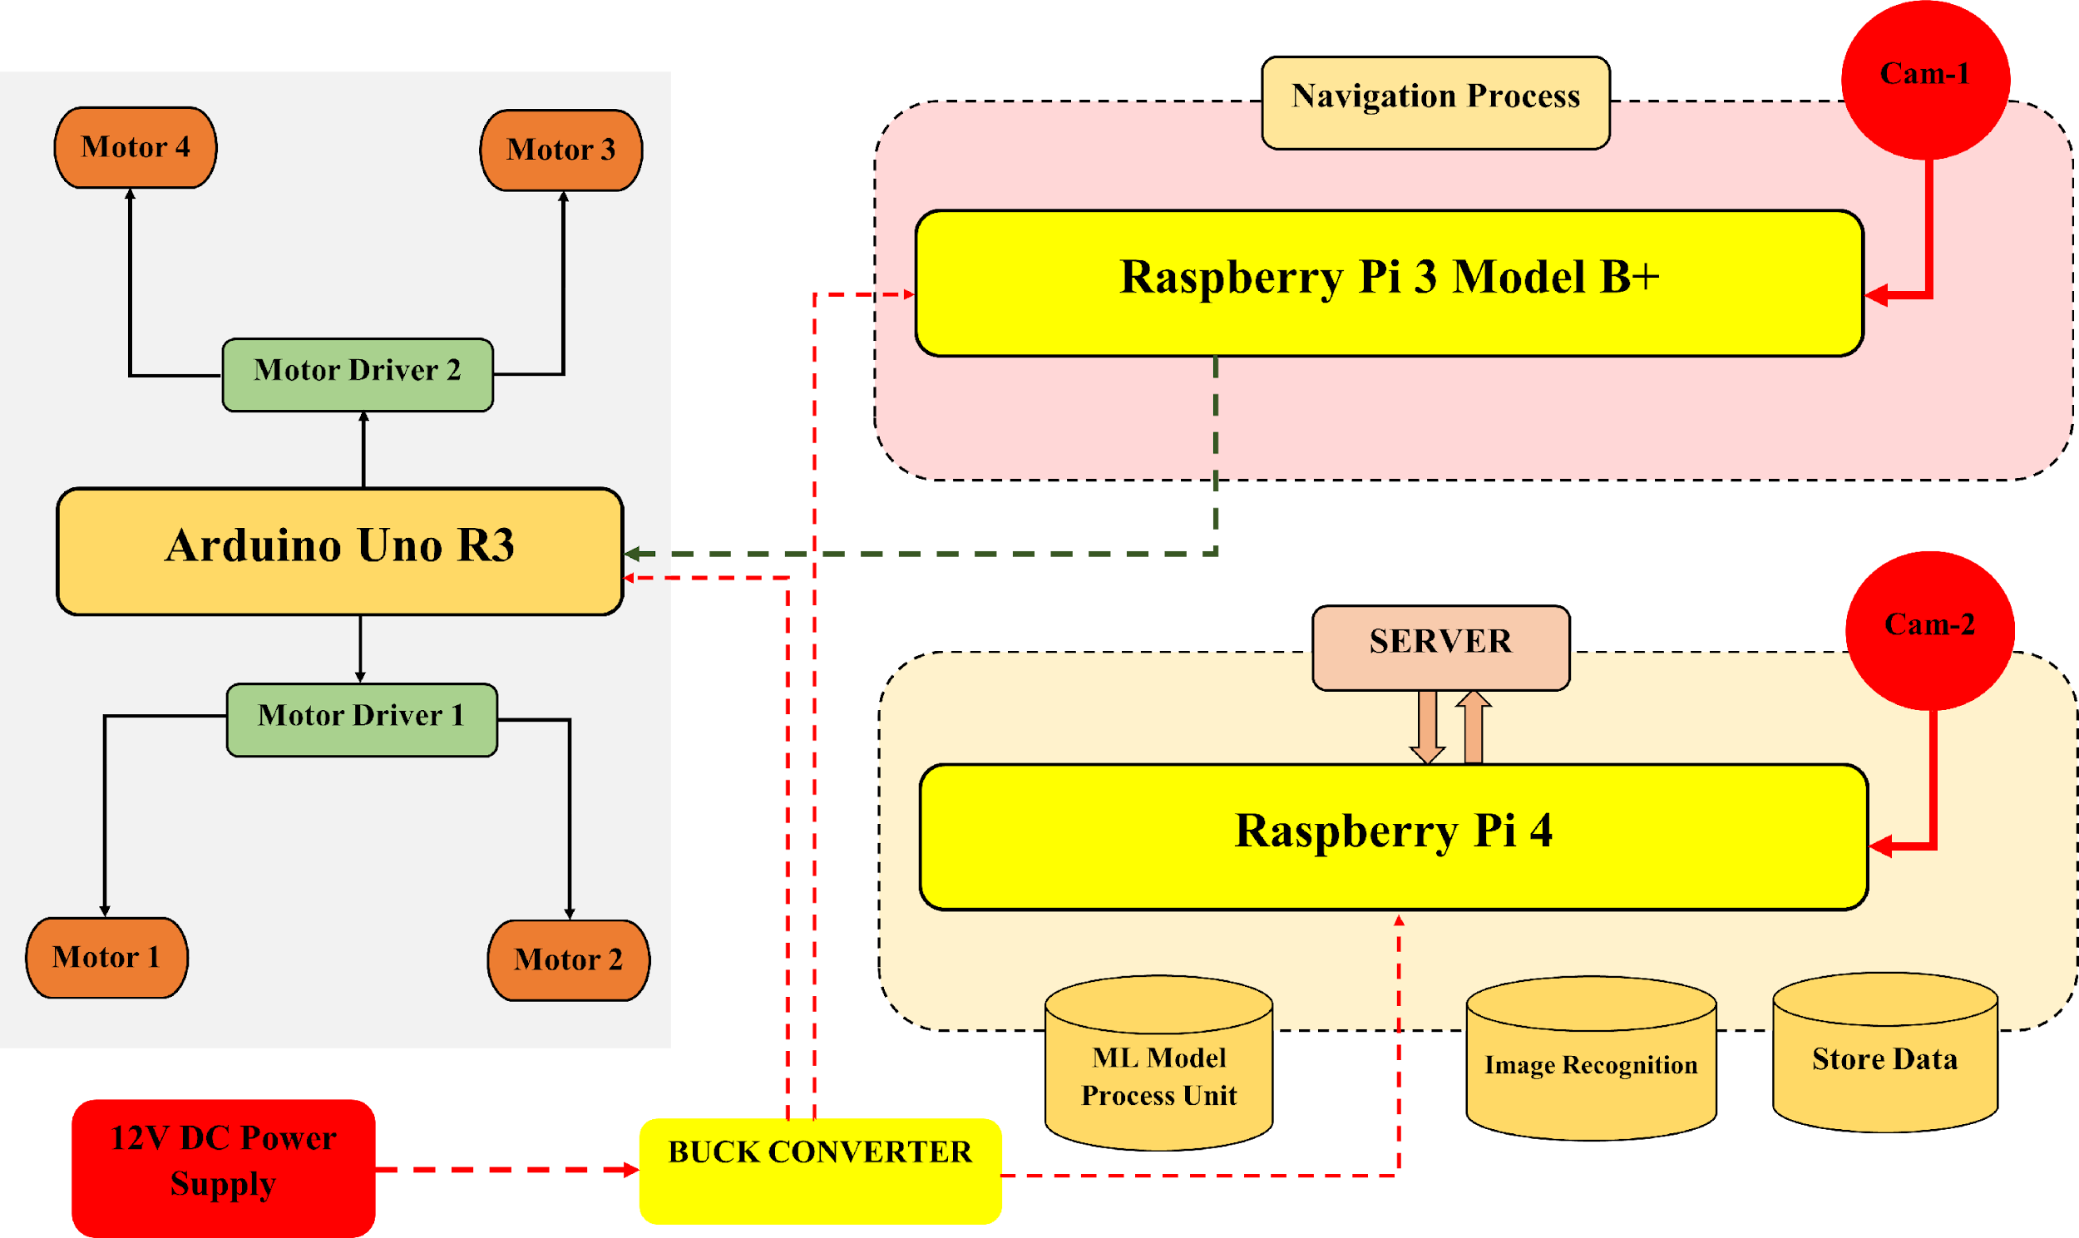
Proposed Models & Methods (1/3)
Figure 5: Robot car working flow chart

Slide 16
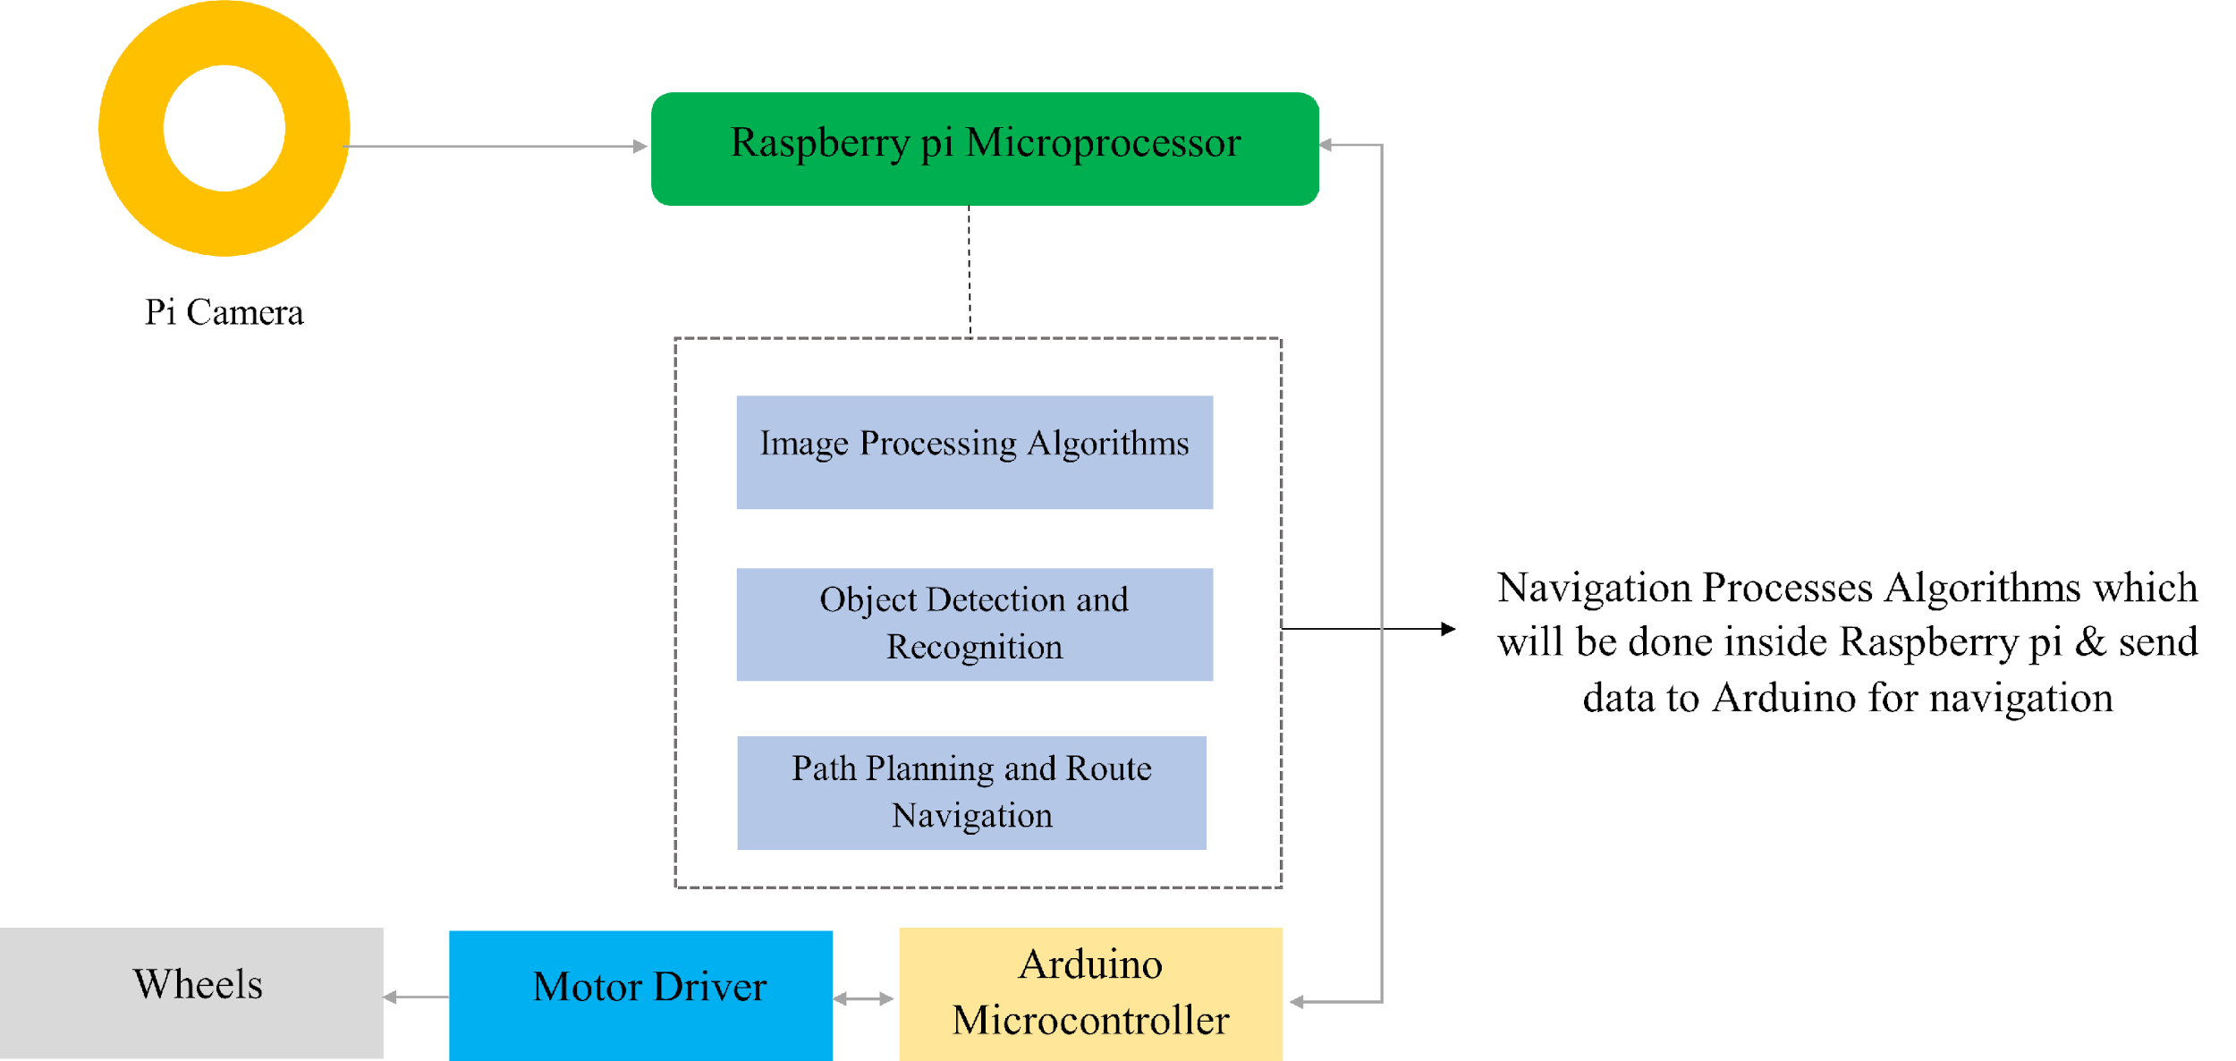
Proposed Models & Methods (2/3)
Figure 6: Robot Car Navigation workflow

Slide 17
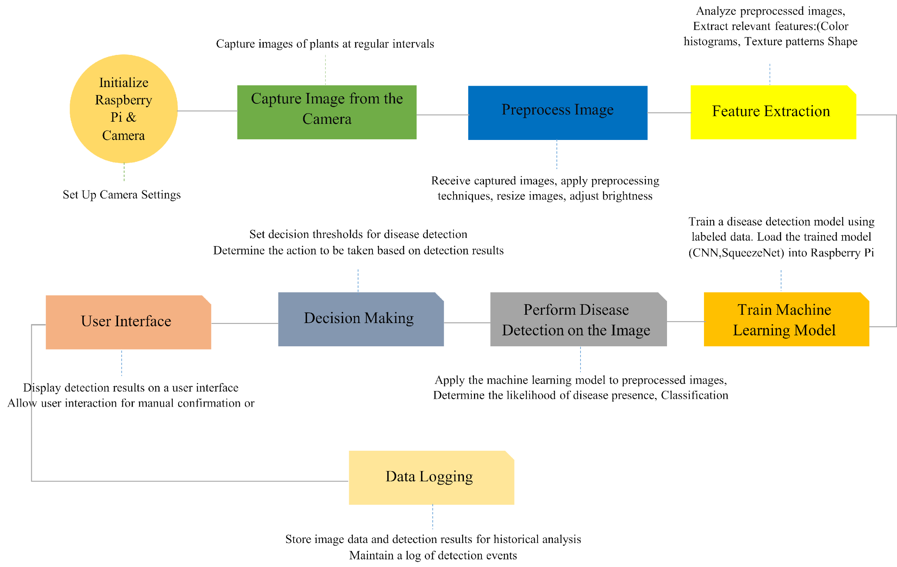
Proposed Models & Methods (3/3)
Figure 7: Robot Car plant disease detection workflow

Slide 18
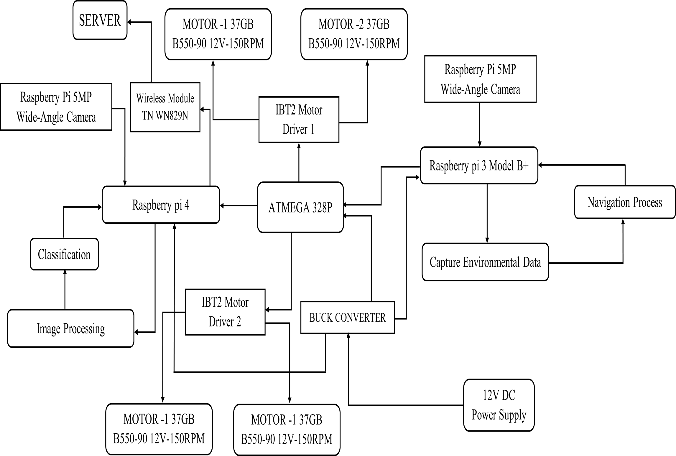
System Architecture
Fig- System Architecture

Slide 19
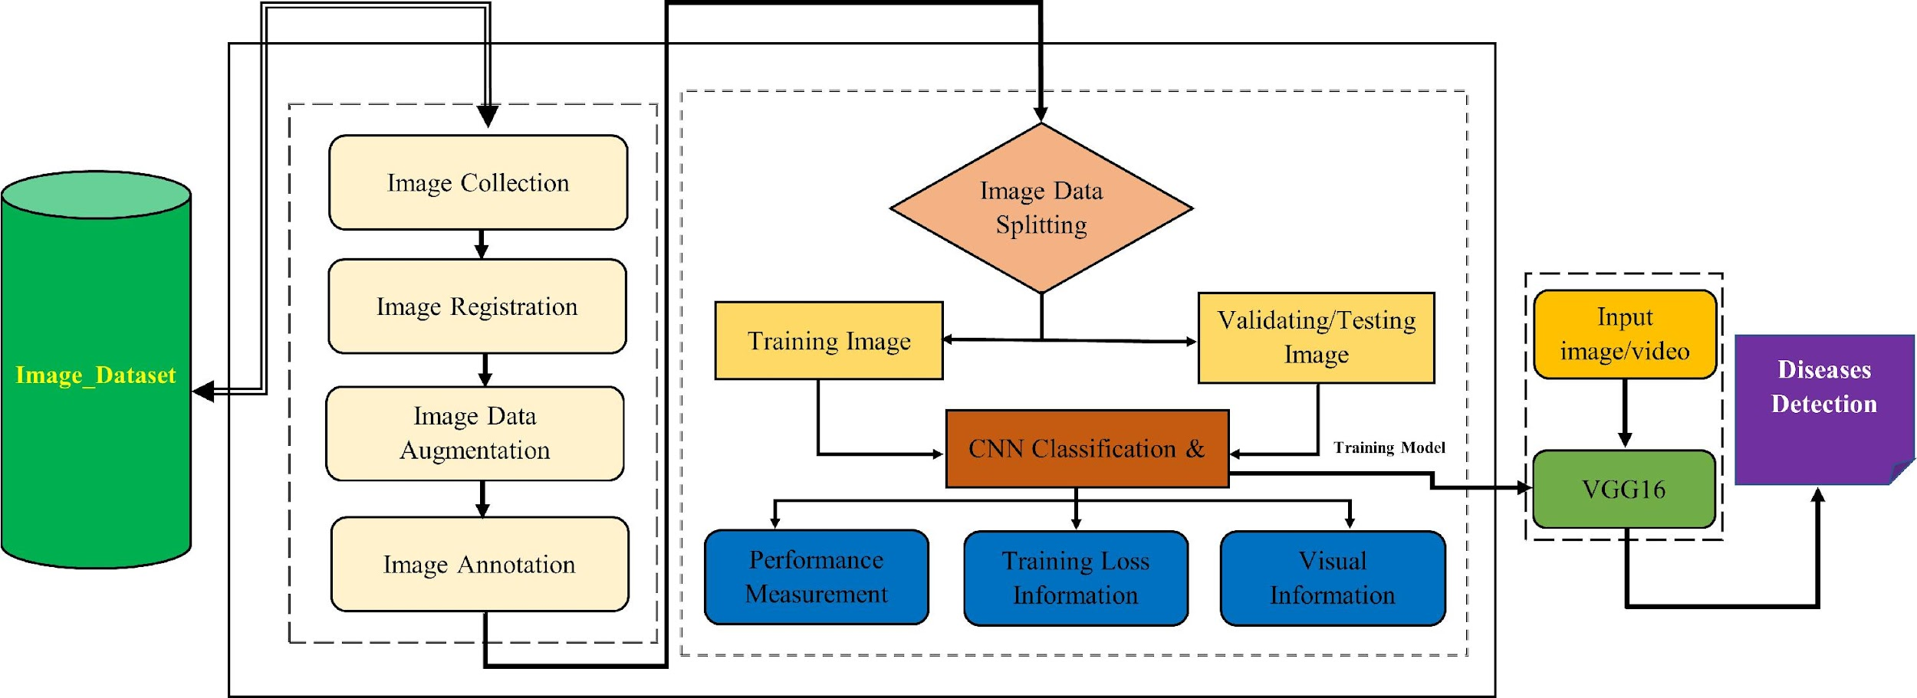
Diagram of Dataset & Model Preparation

Slide 20
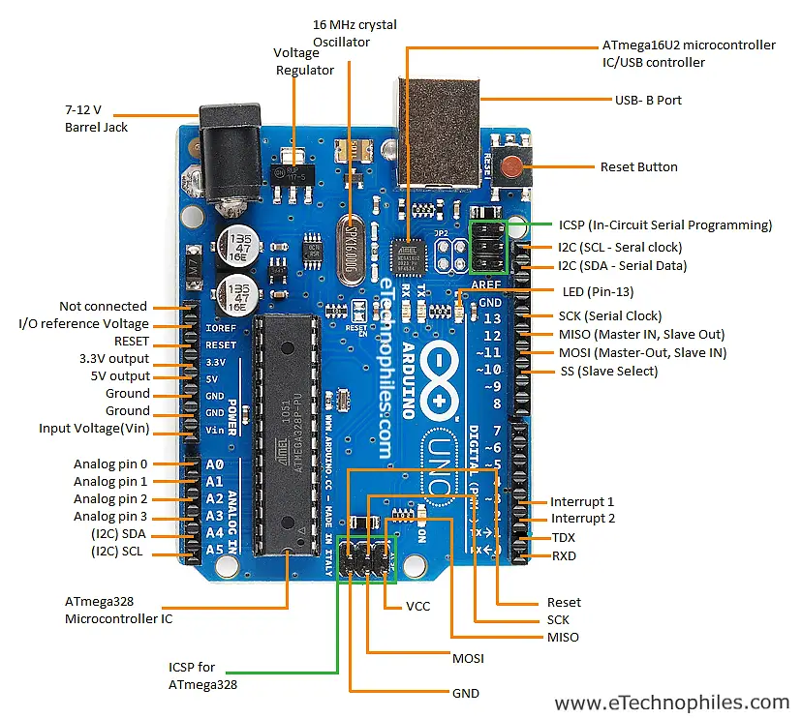
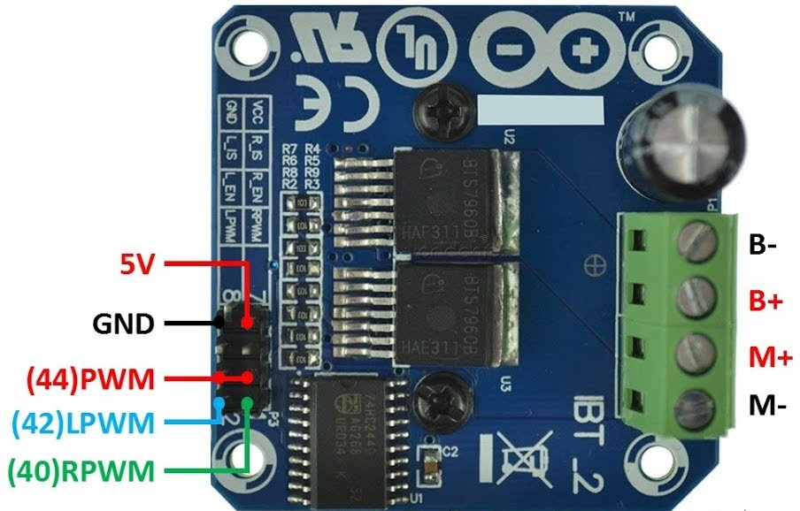
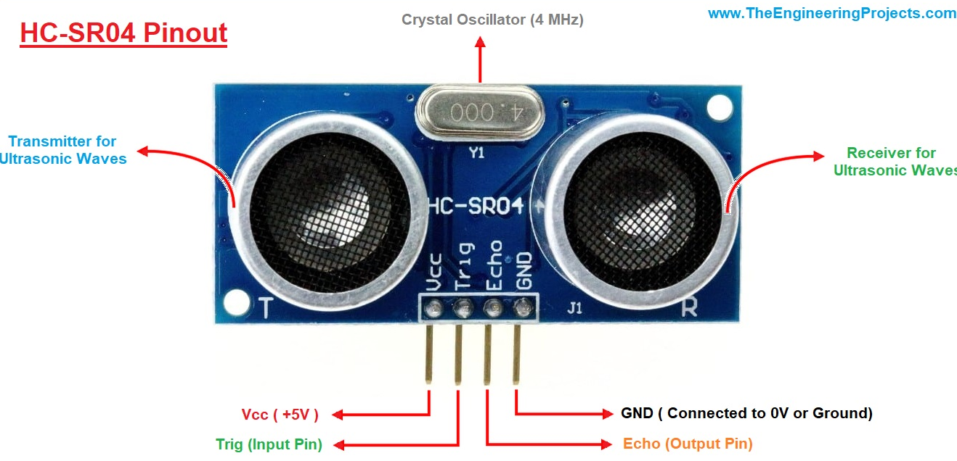
System Components (1/2)
Fig- IBT2 Motor Driver
Fig- Arduino Uno R3
Fig- HC-SR04

Slide 21
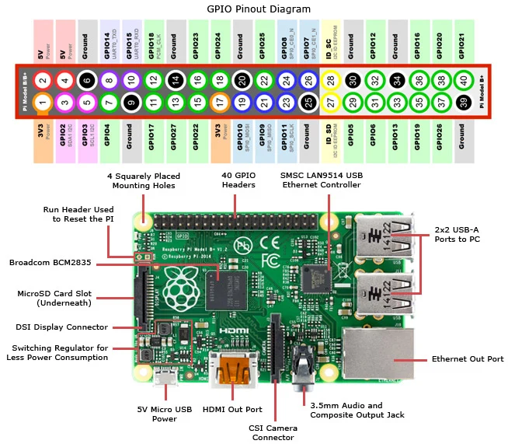
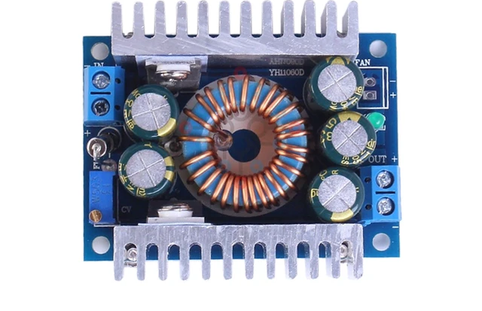
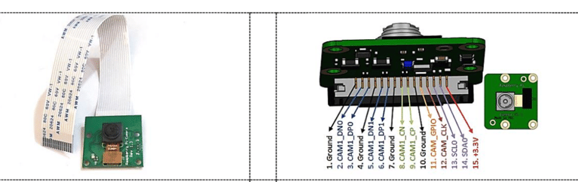
System Components (2/2)
Fig- DC-DC BUCK Converter
Fig- Raspberry pi 3 b+
Fig- Pi Cam

Slide 22
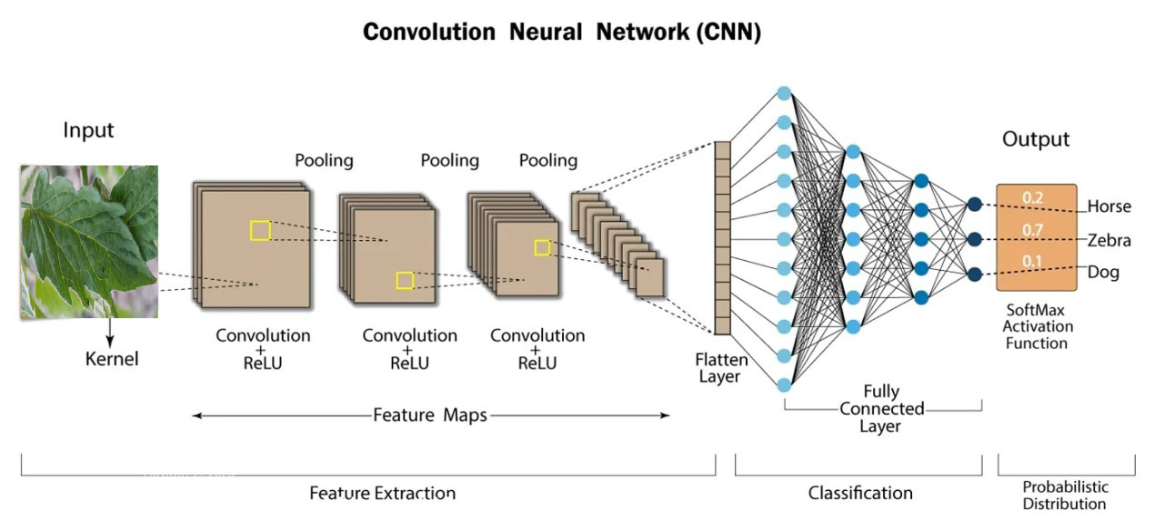
CNN Model
Healthy
PM
TSWV

Slide 23
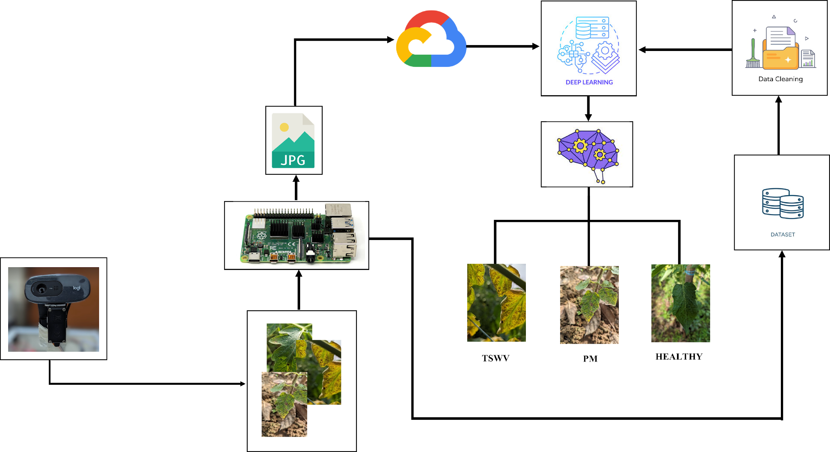
Diseases Detection Flowchart

Slide 24
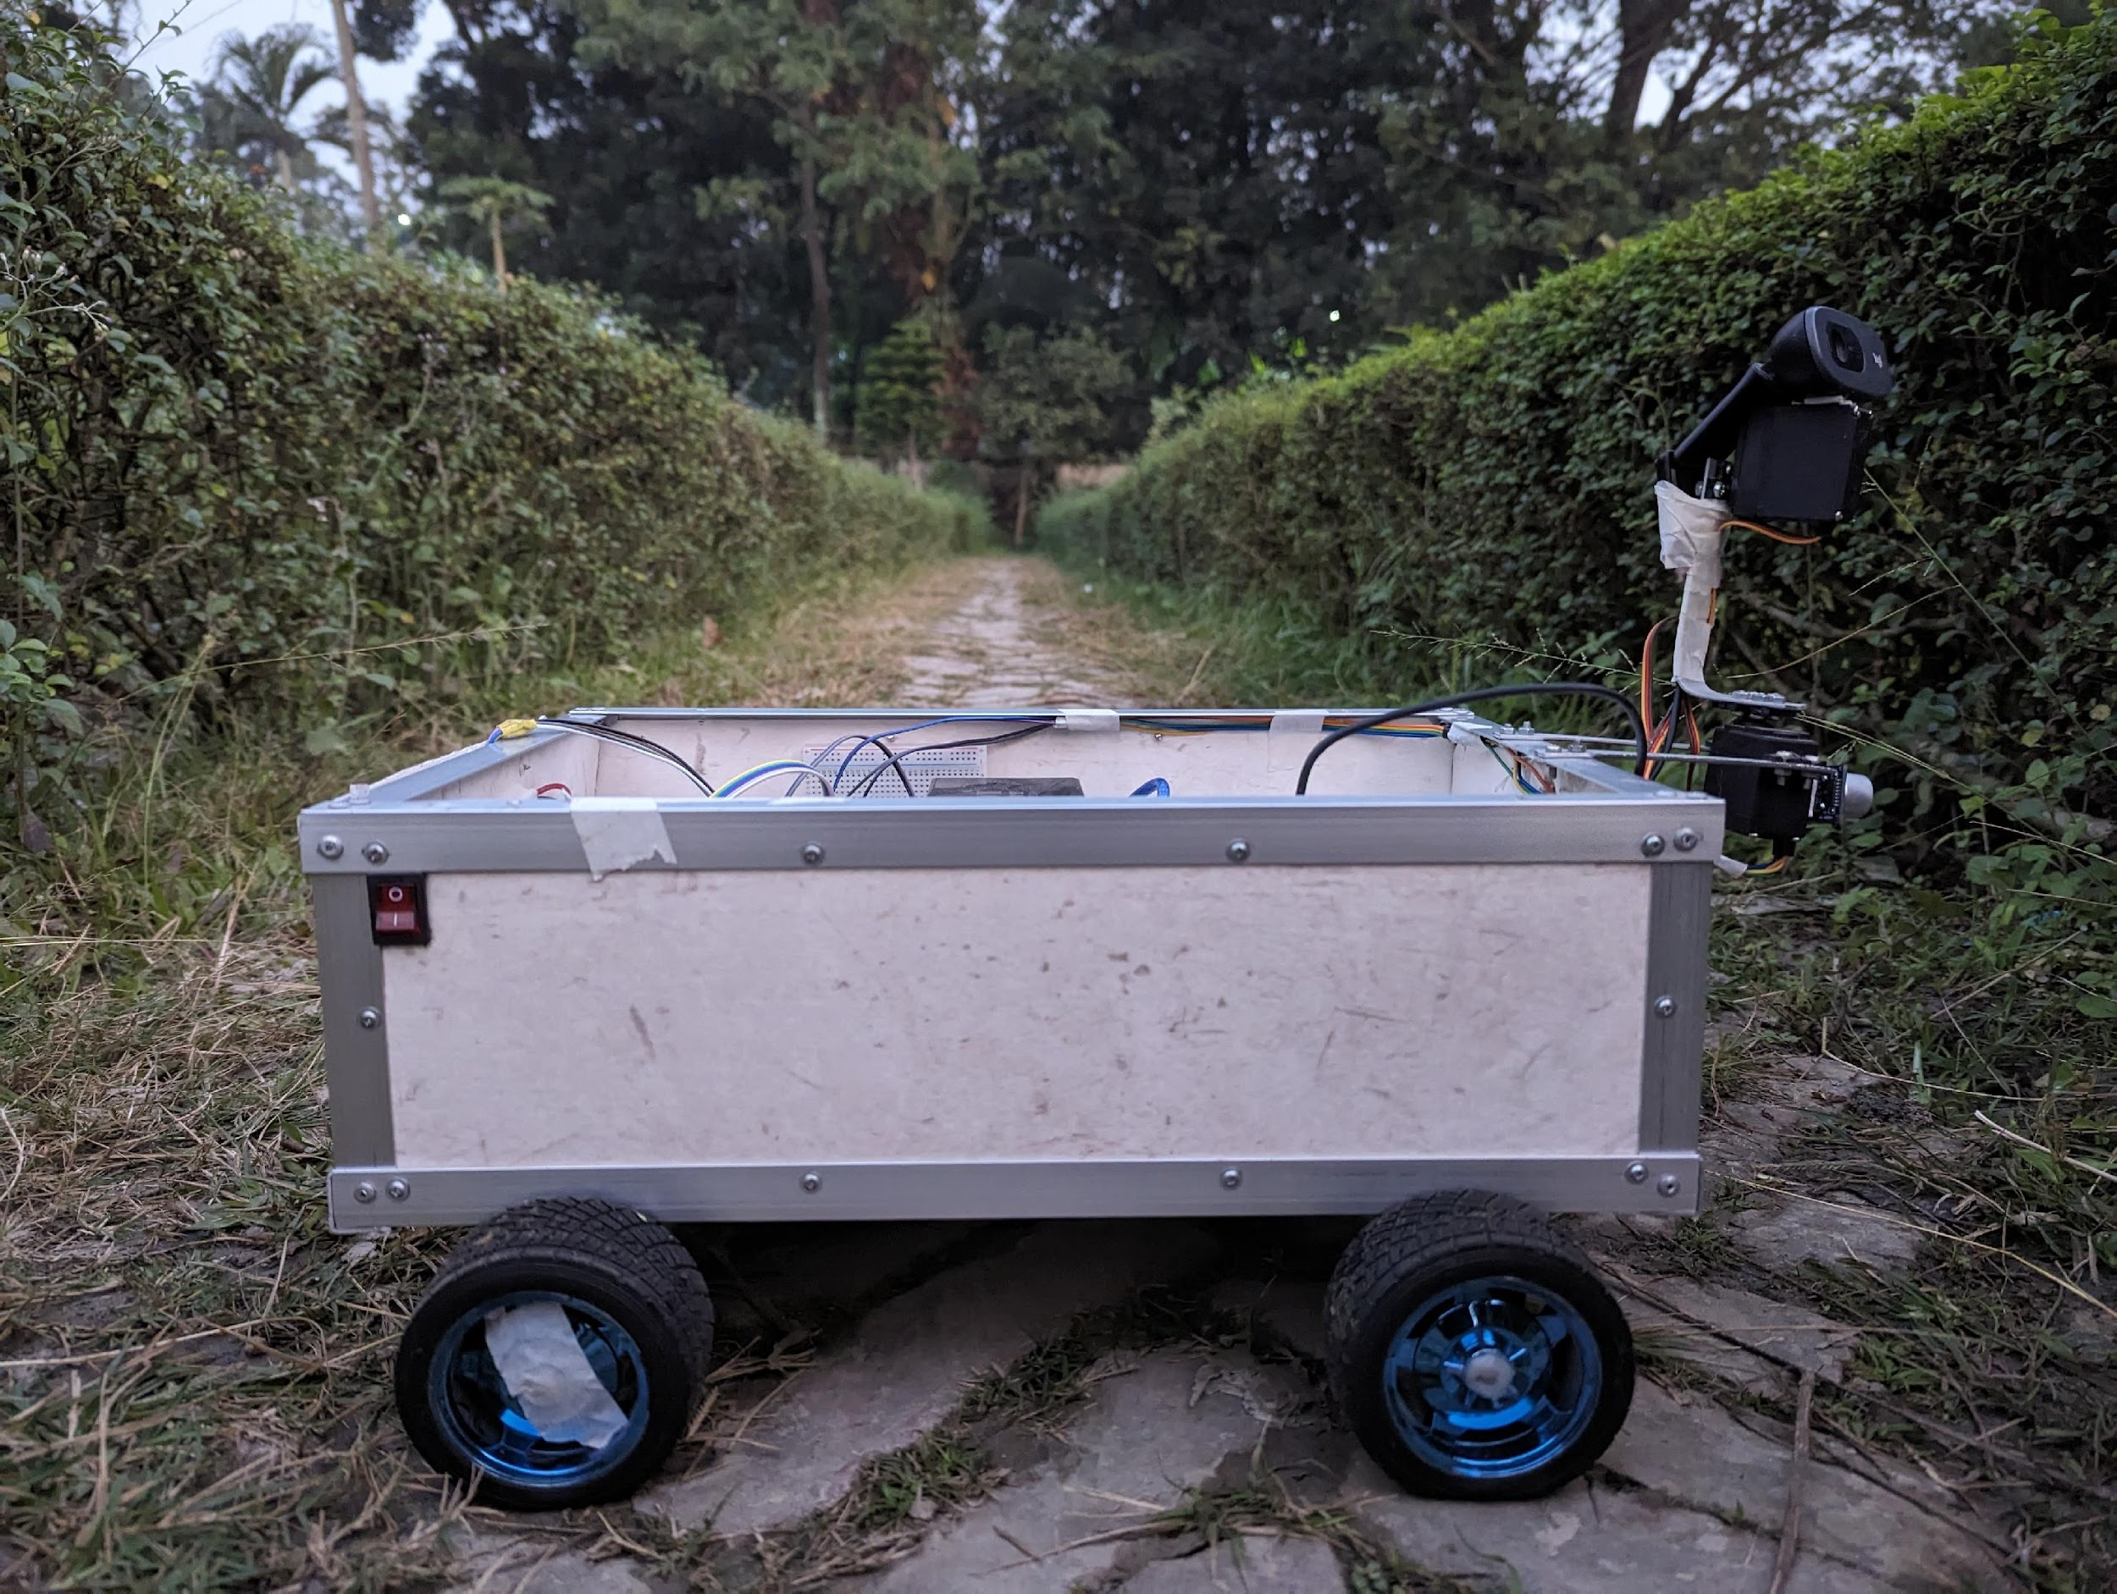
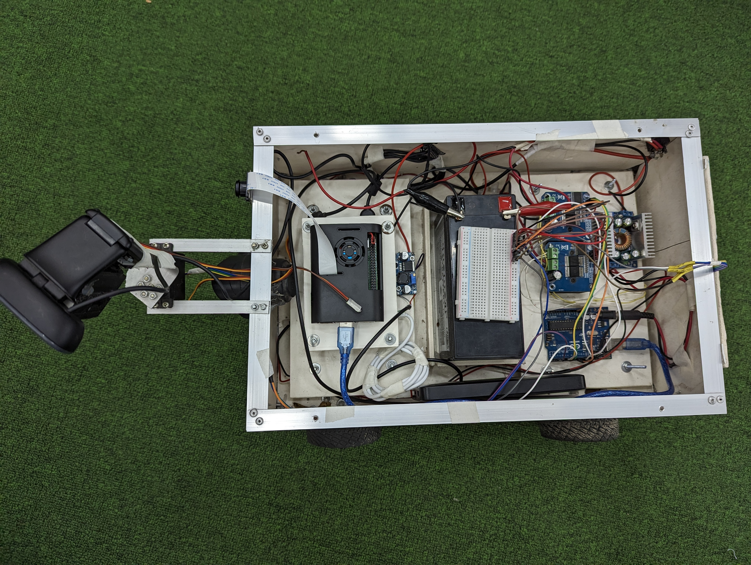
Result’s (1/7) –
Design of The Robotic System
Camera
Navigation Camera
Raspberry Pi 4 (2)
Battery
Buck Converter
Servo
Motor
Wheel
Ultra Sonic Sensor
Buck Converter
Arduino Uno

Slide 25
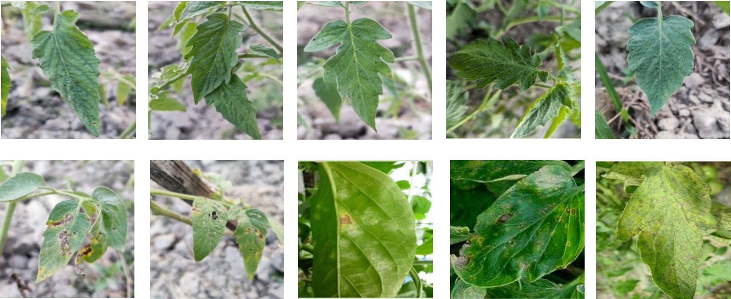
Result’s (2/7) –
Data Acquisition – By system Camera

Slide 26
Result (3/7) – Data split & Accuracy percentage per Epochs
Train - Test Data Split (%) | Training Images | Testing Images
--- | 2000 | 2000
80-20 | 1600 | 400
70-30 | 1300 | 700
60-20 | 1100 | 900
Dataset (Train/Test) Split in % | Accuracy [%]
 | 10 Epochs | 20 Epochs | 30 Epochs | 40 Epochs | 50 Epochs
100* | -- | -- | -- | -- | 89.06
80-20 | 87.50 | 89.06 | 89.84 | 90.62 | 81.25
70-30 | 81.71 | 87.75 | 85.21 | 89.71 | 78.67
60-20 | 83.31 | 84.68 | 87.11 | 88.01 | 83.31
100* - 38 Epochs

Slide 27
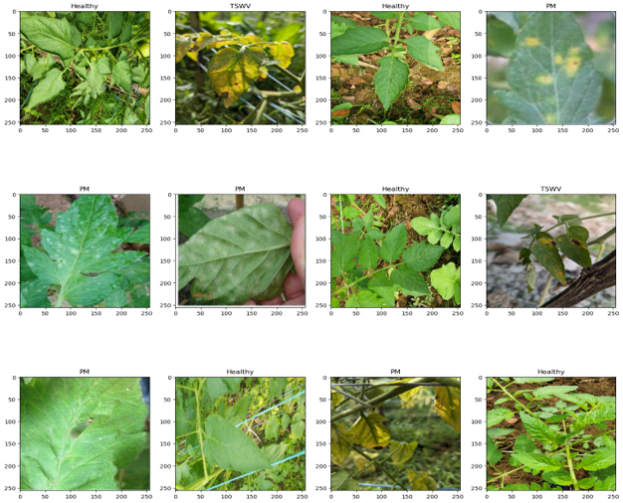
Result’s (4/7) –
Classification of Different Leaves
*PM - Powdery Mildew
*TSWV - Tomato Spot Wild Virus

Slide 28
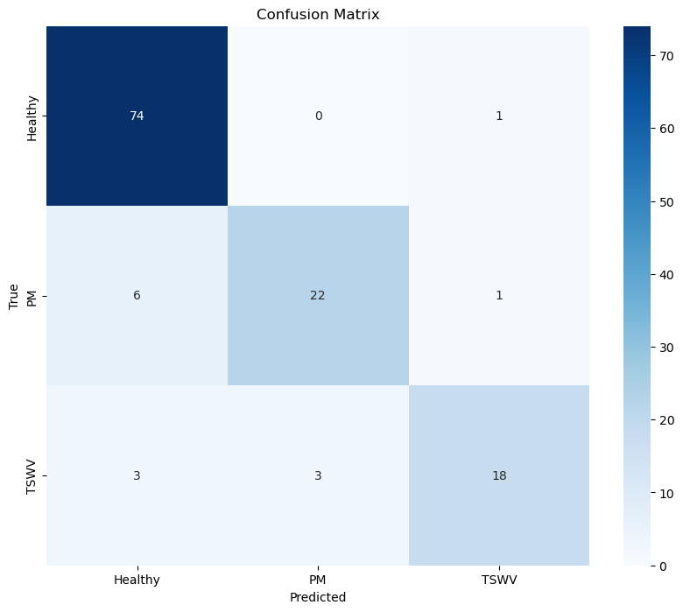
Result (5/7) – Confusion Matrix

Slide 29
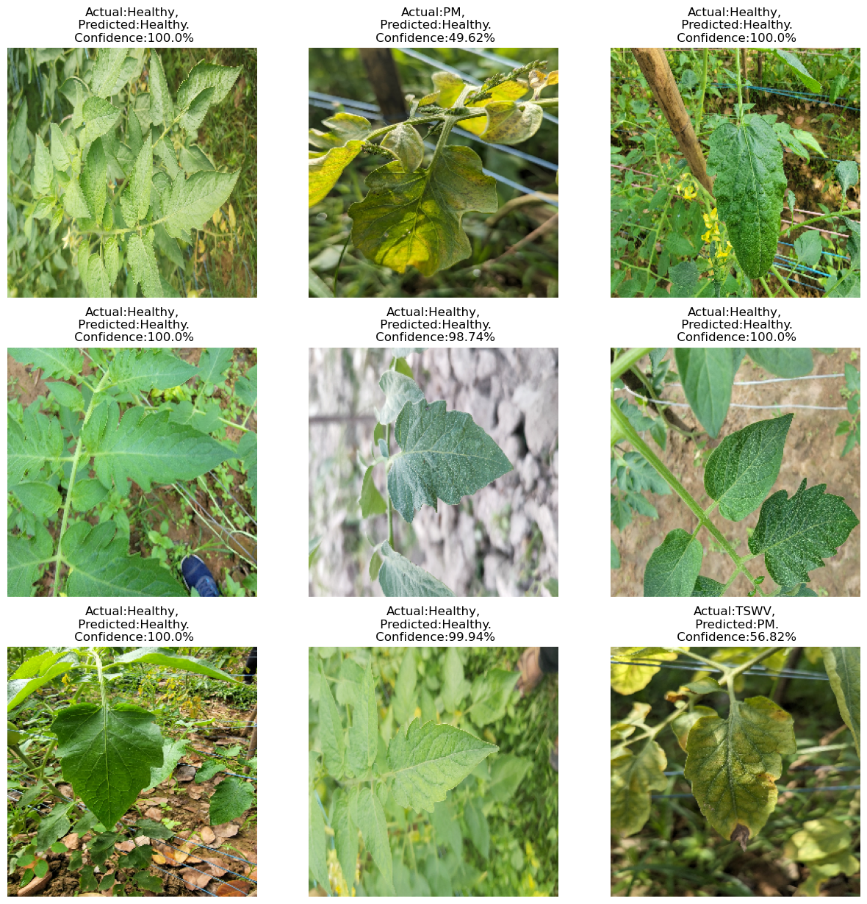
Result’s (6/7) –
Accuracy & Prediction of Different Leaves

Slide 30
Result’s (7/7) –
Prediction of Different Leaves by system camera
https://youtu.be/I_aIbu0wY-s
https://eco-rover.vibd.me/

Slide 31
References (1/2)
Schor, Noa, et al. "Robotic disease detection in greenhouses: combined detection of powdery mildew and tomato spotted wilt virus." IEEE Robotics and Automation Letters 1.1 (2016): 354-360.
Durmuş, Halil, Ece Olcay Güneş, and Mürvet Kırcı. "Disease detection on the leaves of the tomato plants by using deep learning." 2017 6th International conference on agro-geoinformatics. IEEE, 2017.
Mohanty, Sharada P., David P. Hughes, and Marcel Salathé. "Using deep learning for image-based plant disease detection." Frontiers in plant science 7 (2016): 1419.
Pilli, Sai Kirthi, et al. "eAGROBOT—A robot for early crop disease detection using image processing." 2015 2nd International Conference on Electronics and Communication Systems (ICECS). IEEE, 2015.
Wspanialy, Patrick, and Medhat Moussa. "Early powdery mildew detection system for application in greenhouse automation." Computers and Electronics in Agriculture 127 (2016): 487-494.
Ashok, Surampalli, et al. "Tomato leaf disease detection using deep learning techniques." 2020 5th International Conference on Communication and Electronics Systems (ICCES). IEEE, 2020.
Khirade, Sachin D., and A. B. Patil. "Plant disease detection using image processing." 2015 International conference on computing communication control and automation. IEEE, 2015.
Fatima, Neda, Salman Ahmad Siddiqui, and Anwar Ahmad. "IoT-based smart greenhouse with disease prediction using deep learning." International Journal of Advanced Computer Science and Applications 12.7 (2021).
Ahmed, Shahad, and Saman Hameed Ameen. "Detection and Classification of Leaf Disease Using Deep Learning for a Greenhouses’ Robot." IRAQI JOURNAL OF COMPUTERS, COMMUNICATIONS, CONTROL AND SYSTEMS ENGINEERING 21.4 (2021): 15-28.
Shrestha, Garima, Majolica Das, and Naiwrita Dey. "Plant disease detection using CNN." 2020 IEEE applied signal processing conference (ASPCON). IEEE, 2020.
Jasim, Marwan Adnan, and Jamal Mustafa Al-Tuwaijari. "Plant leaf diseases detection and classification using image processing and deep learning techniques." 2020 International Conference on Computer Science and Software Engineering (CSASE). IEEE, 2020.

Slide 32
References (2/2)
R. Oberti, M. Marchi, P. Tirelli, A. Calcante, M. Iriti, and A.N. Borghese, "Automatic detection of Powdery mildew on grapevine leaves by image analysis: Optimal view-angle range to increase the sensitivity," Computers and Electronics in Agriculture, vol. 104, pp. 1-8, June 2014.
J. Franke, and G. Menz, "Multi-temporal wheat disease detection by multi-spectral remote sensing," Precision Agriculture, vol. 8, no. 3, pp. 161–172, June 2007.
30. N. Schor, S. Berman, A. Dombrovsky, Y. Elad, T. Ignat, and A. Bechar, "Perception apparatus design for a robotic system for greenhouse pepper disease detection," Precision Agriculture, submitted for publication.
Nambuthiri, Susmitha, et al. "Moving toward sustainability with alternative containers for greenhouse and nursery crop production: A review and research update." HortTechnology 25.1 (2015): 8-16.
Aznar-Sánchez, José A., et al. "An analysis of global research trends on greenhouse technology: towards a sustainable agriculture." International journal of environmental research and public health 17.2 (2020): 664.
Dhingra, Gittaly, Vinay Kumar, and Hem Dutt Joshi. "Study of digital image processing techniques for leaf disease detection and classification." Multimedia Tools and Applications 77 (2018): 19951-20000.
Cynthia, Shamse Tasnim, et al. "Automated detection of plant diseases using image processing and faster R-CNN algorithm." 2019 International Conference on Sustainable Technologies for Industry 4.0 (STI). IEEE, 2019.
Escamilla-García, Axel, et al. "Applications of artificial neural networks in greenhouse technology and overview for smart agriculture development." Applied Sciences 10.11 (2020): 3835.
Mattihalli, Channamallikarjuna, et al. "Real time automation of agriculture land, by automatically detecting plant leaf diseases and auto medicine." 2018 32nd International Conference on Advanced Information Networking and Applications Workshops (WAINA). IEEE, 2018.
Yuan, Yuan, et al. "Advanced agricultural disease image recognition technologies: A review." Information Processing in Agriculture 9.1 (2022): 48-59.
Jumat, Muhammad Hanif, Mohd Saleem Nazmudeen, and Au Thien Wan. "Smart farm prototype for plant disease detection, diagnosis & treatment using IoT device in a greenhouse." (2018): 48-4.
Madiwalar, Shriroop C., and Medha V. Wyawahare. "Plant disease identification: A comparative study." 2017 International Conference on Data Management, Analytics and Innovation (ICDMAI). IEEE, 2017.
Padmavathi, K., and K. Thangadurai. "Implementation of RGB and grayscale images in plant leaves disease detection–comparative study." Indian Journal of Science and Technology 9.6 (2016): 1-6.

Slide 33
Thank You

